Slide 1
Adding Authentication to Single-page Web Applications

Slide 2
Spring Security can secure the backend for your Single-page application.

Slide 3

Overview
Configure Spring Security and Spring Boot for single-page applications.
- Form and Basic authentication

Slide 4
Delegating Authentication to Spring
Security

Slide 5




Spring backed
SPA
GET /portfolio

Slide 6

browser
cryptoportfolio.com
Spring Security
filters
Servlets
DispatcherServlet

Slide 7

Demo Application Architecture
browser
Backend
Spring Boot
React
Spring Security
DispatcherServlet

Slide 8
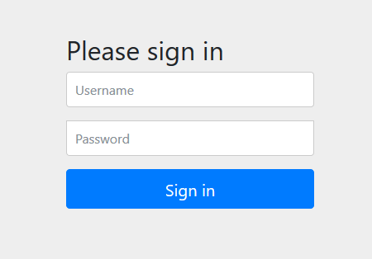
browser
cryptoportfolio.com
Spring Security
filters
Servlets
Redirect /login
DispatcherServlet

Slide 9

browser
Spring Security
filters
Servlets
Response: index.html
DispatcherServlet

Slide 10
browser
Spring Security
filters
Servlets
Redirect /login
DispatcherServlet

Slide 11
Configuring CSRF Protection in Your SPA

Slide 12
Even with Single-page applications you still need CSRF protection.

Slide 13
withHttpOnlyFalse()
The browser will allow javascript originating from the same origin to access the cookie.

Slide 14
Logging Out

Slide 15


browser
cryptoportfolio.com
Spring Security
filters
Servlets
DispatcherServlet

Slide 16
browser
cryptoportfolio.com
Spring Security
filters
Servlets
Redirect /login
DispatcherServlet

Slide 17
Authenticating via an External Login Page

Slide 18
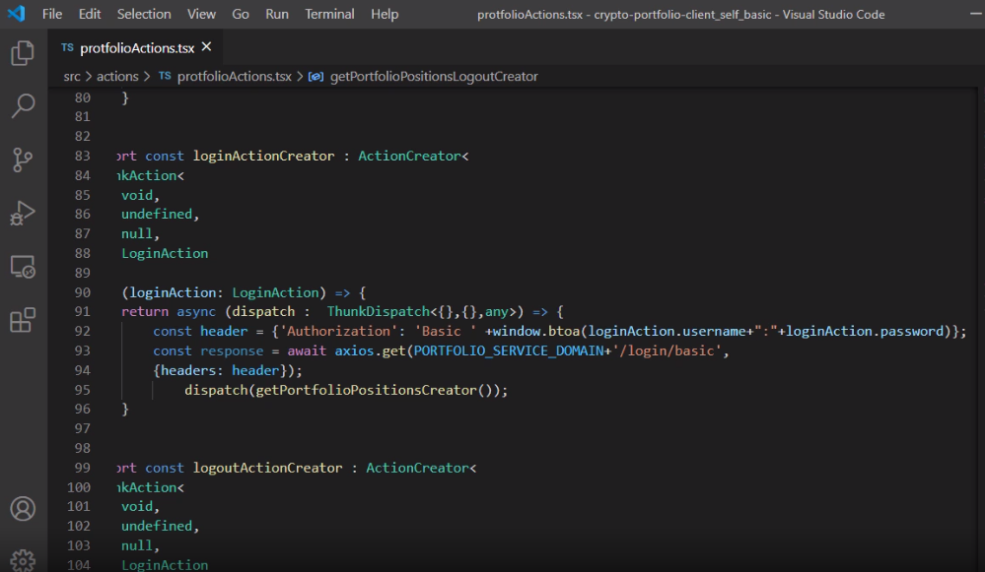

Slide 19
Wrap up
In this module you learned how to setup Spring Security and Spring Boot to accommodate a SPA front end.

Slide 20

Same as origin
crypto.com

Slide 21

Other Types of Setups
Stateless via API Gateway
Cross-origin requests
API Gateway
crypto.com
c.com

Slide 22

Up Next
How to correctly handle Authentication and Authorization exceptions.

